Slide 1
MooCam – AI-Powered Breed-predictor App
Revolutionizing Livestock Management with Artificial Intelligence

Slide 2
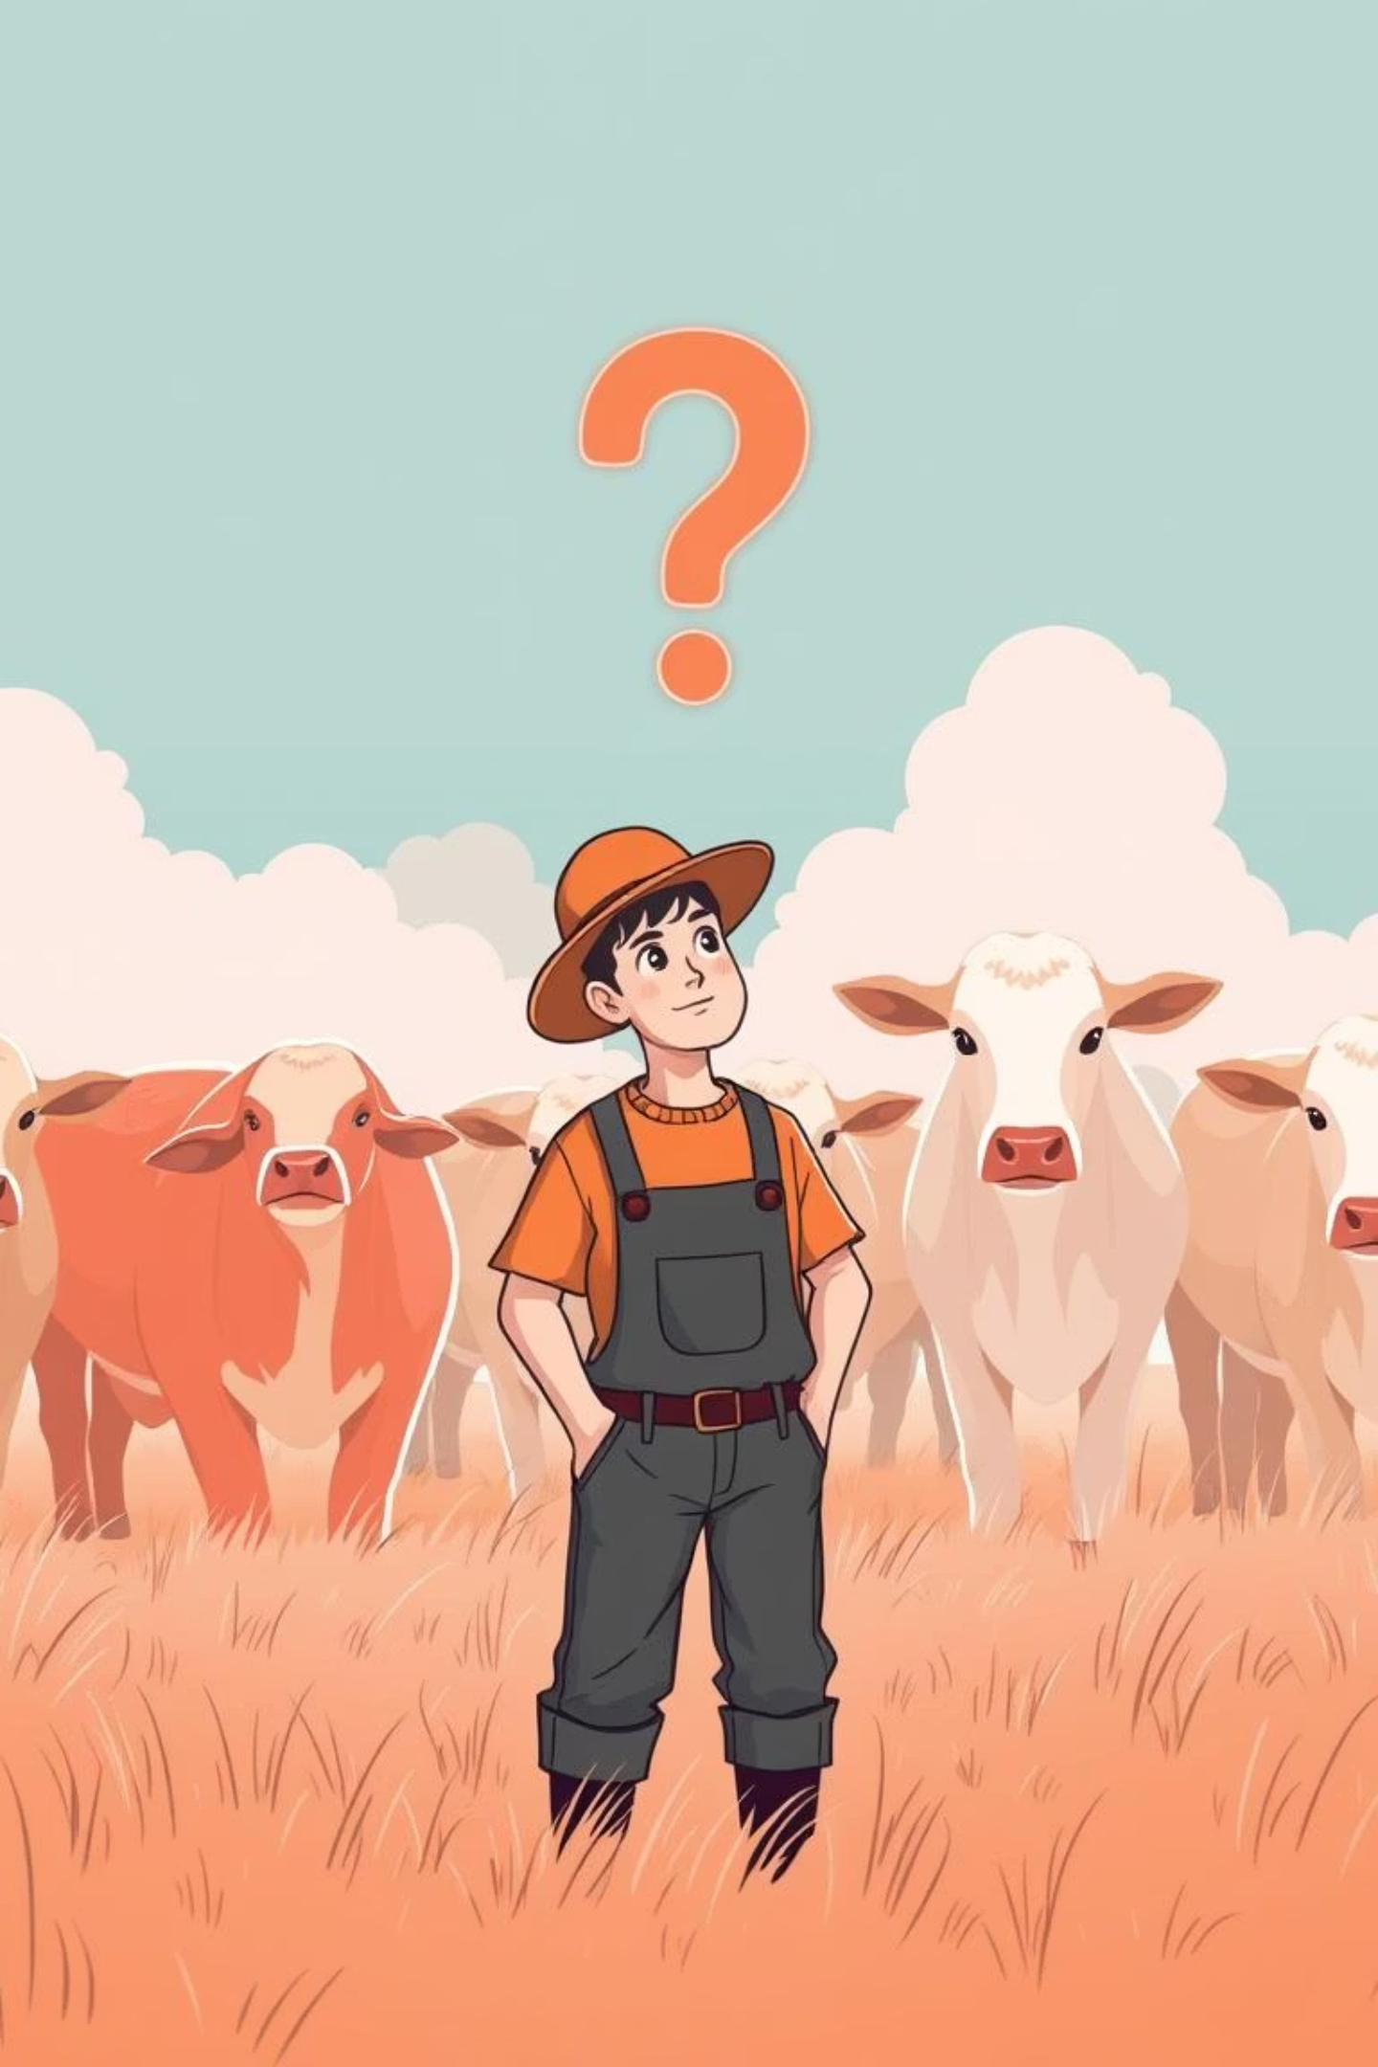
Problem Statement
For farmers in India, correctly identifying the breeds of cattle and buffaloes is a major challenge. Different breeds have distinct characteristics such as milk yield, disease resistance, and adaptability. Without accurate breed identification, farmers struggle to make informed decisions regarding breeding, healthcare, and sales. This results in reduced productivity and financial losses.

Slide 3
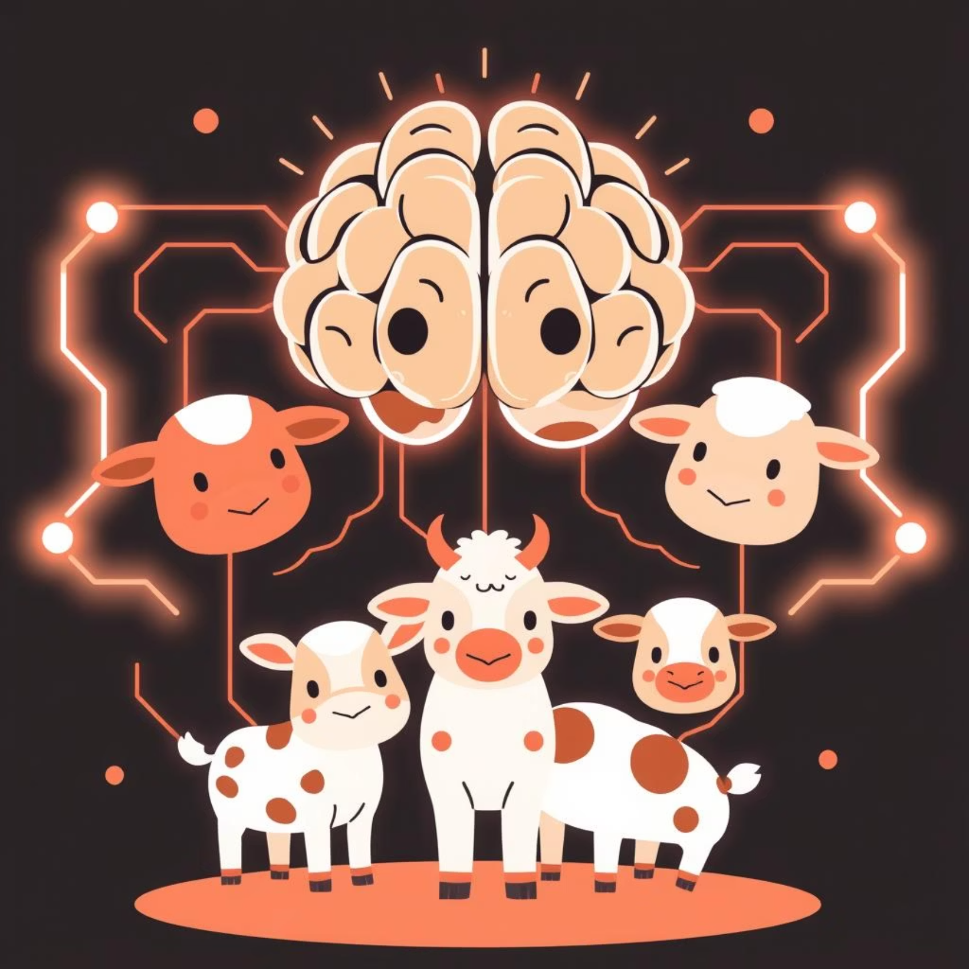
Our Vision: Objective
Develop an AI-powered solution that can recognize cattle and buffalo breeds from images. The solution should be accessible through a simple mobile application, enabling farmers to capture a photo of their animal and instantly receive breed information.

Slide 4

Introducing MooCam (Breed predictor app)
Smart.Simple.Reliable.
Your pocket expert for livestock management.

Slide 5




What is the workflow?
AI Prediction: Image is preprocessed and classified using MobileNet (TFLite).
Backend Integration: Supabase stores images, predictions, and user history with secure authentication.
Feedback & Analytics : Farmers provide feedback, enabling accuracy improvement and trend analysis.
User Interaction:
Android app captures cattle images using CameraX

Slide 6



What MooCam Does?
Core Features:
- Instant breed prediction with confidence score.
- Prediction history accessible to users.
- On-device inference ensures low latency and offline support.
Integrated MobileNet .tflite model covering major cattle breeds.
Supabase database for structured storage and authentication.
Live demo showcasing real-time cattle breed recognition.
Offline Mode
Ensure uninterrupted functionality even in remote areas with limited internet connectivity.

Slide 7




How We Train Our AI Model
Dataset: Thousands of images of cattle and buffalo breeds, organized and labeled.
Preprocessing: Images resized (224×224), normalized, and augmented (rotation, flip, zoom).
Model: Convolutional Neural Network (TensorFlow/Keras) learns horn shape, coat color, body structure.
Training : Dataset split into training/validation, trained for multiple epochs, accuracy evaluated.
Deployment: Model saved in TFLite format, integrated with app for instant predictions.*
Takeaways: CNNs auto-extract features, accuracy improves with more data, scalable to more breeds.

Slide 8

Expected Outcomes:
Accurate and quick breed identification for farmers.
Smarter breeding, health, and market decisions.
Increased milk yield and livestock productivity.
Higher farmer income and reduced losses.
Scalable solution, extendable to more breeds and other livestock.
Contribution towards AI-driven sustainable agriculture.

